Slide 1
Alien design
Prepared by Janani Rajesh Kumar
GR090051
GRIP BIOLOGY ACTIVITY
OH MY GOD, LOOK AN ALIEN !

Slide 2
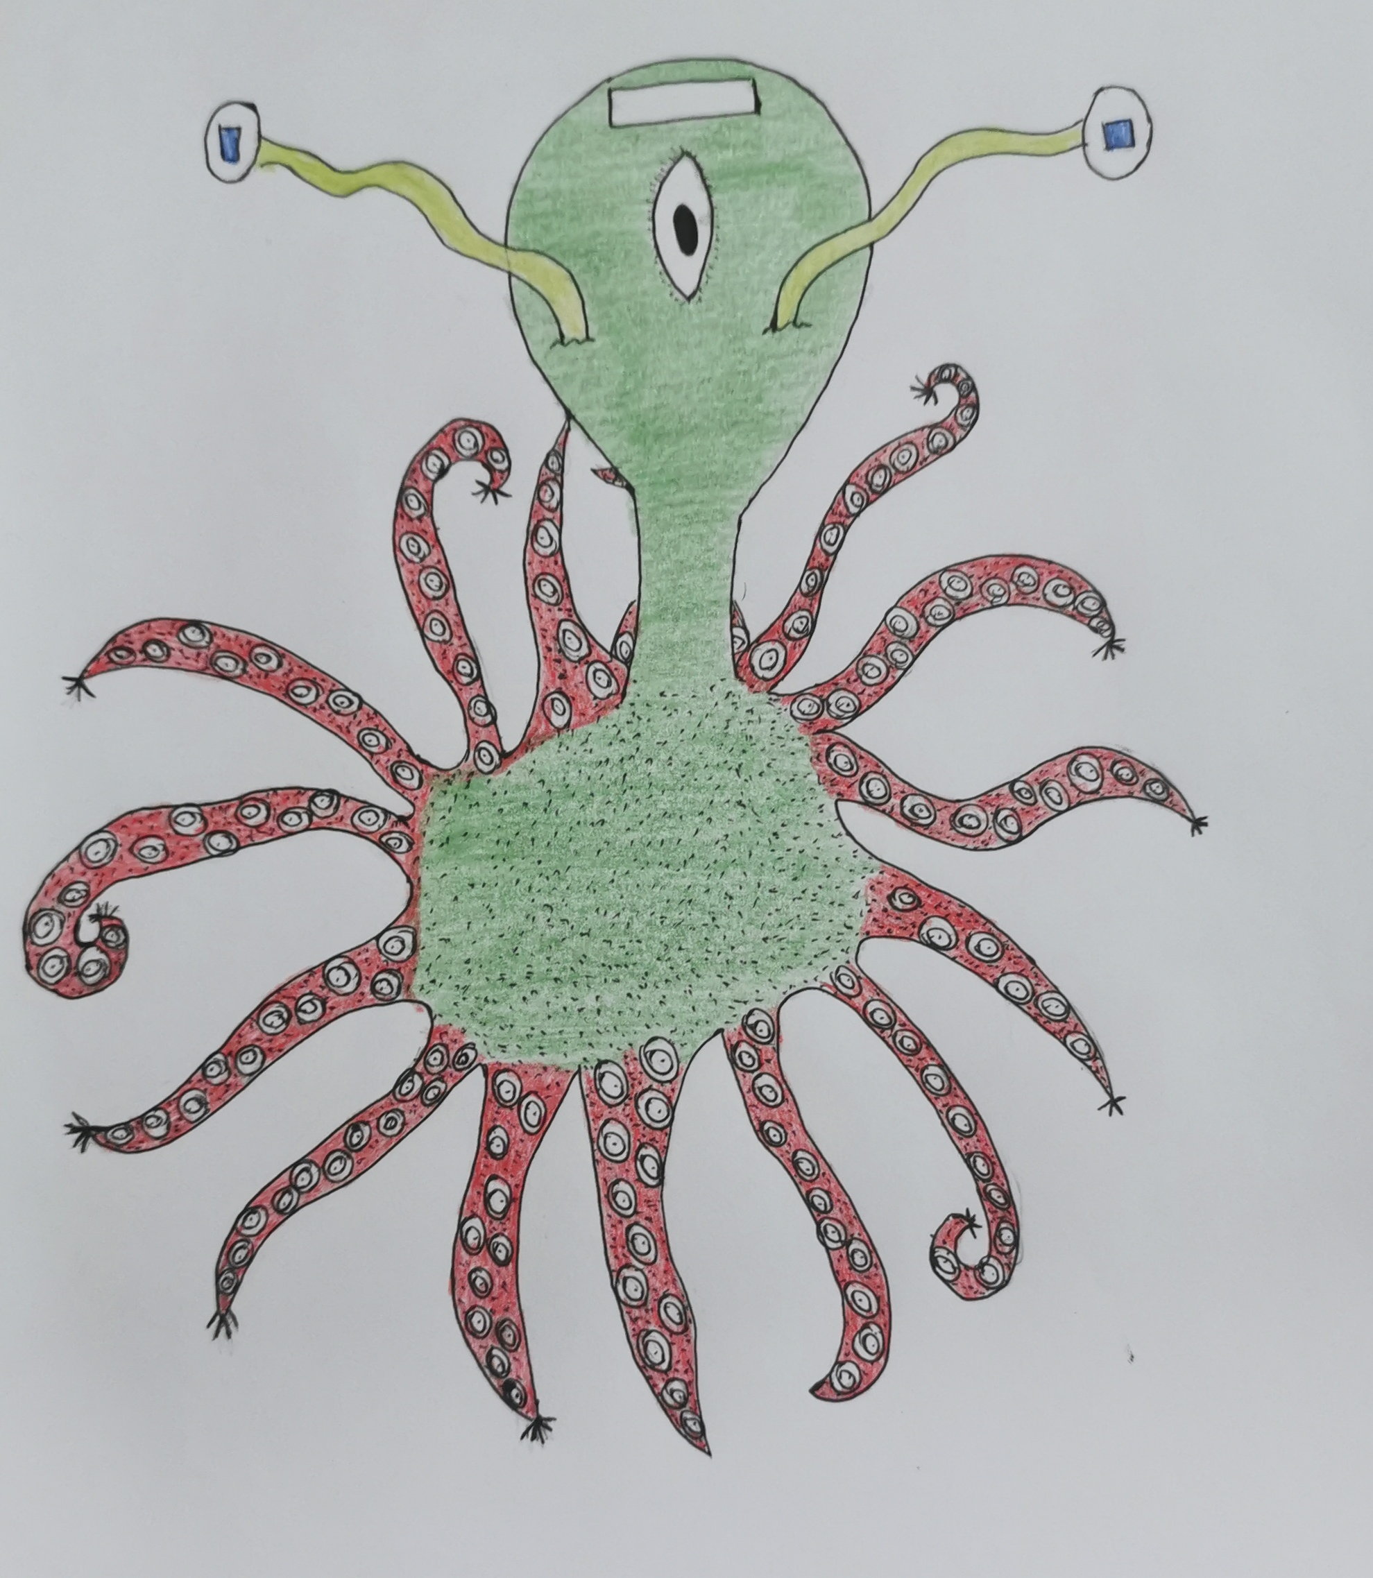
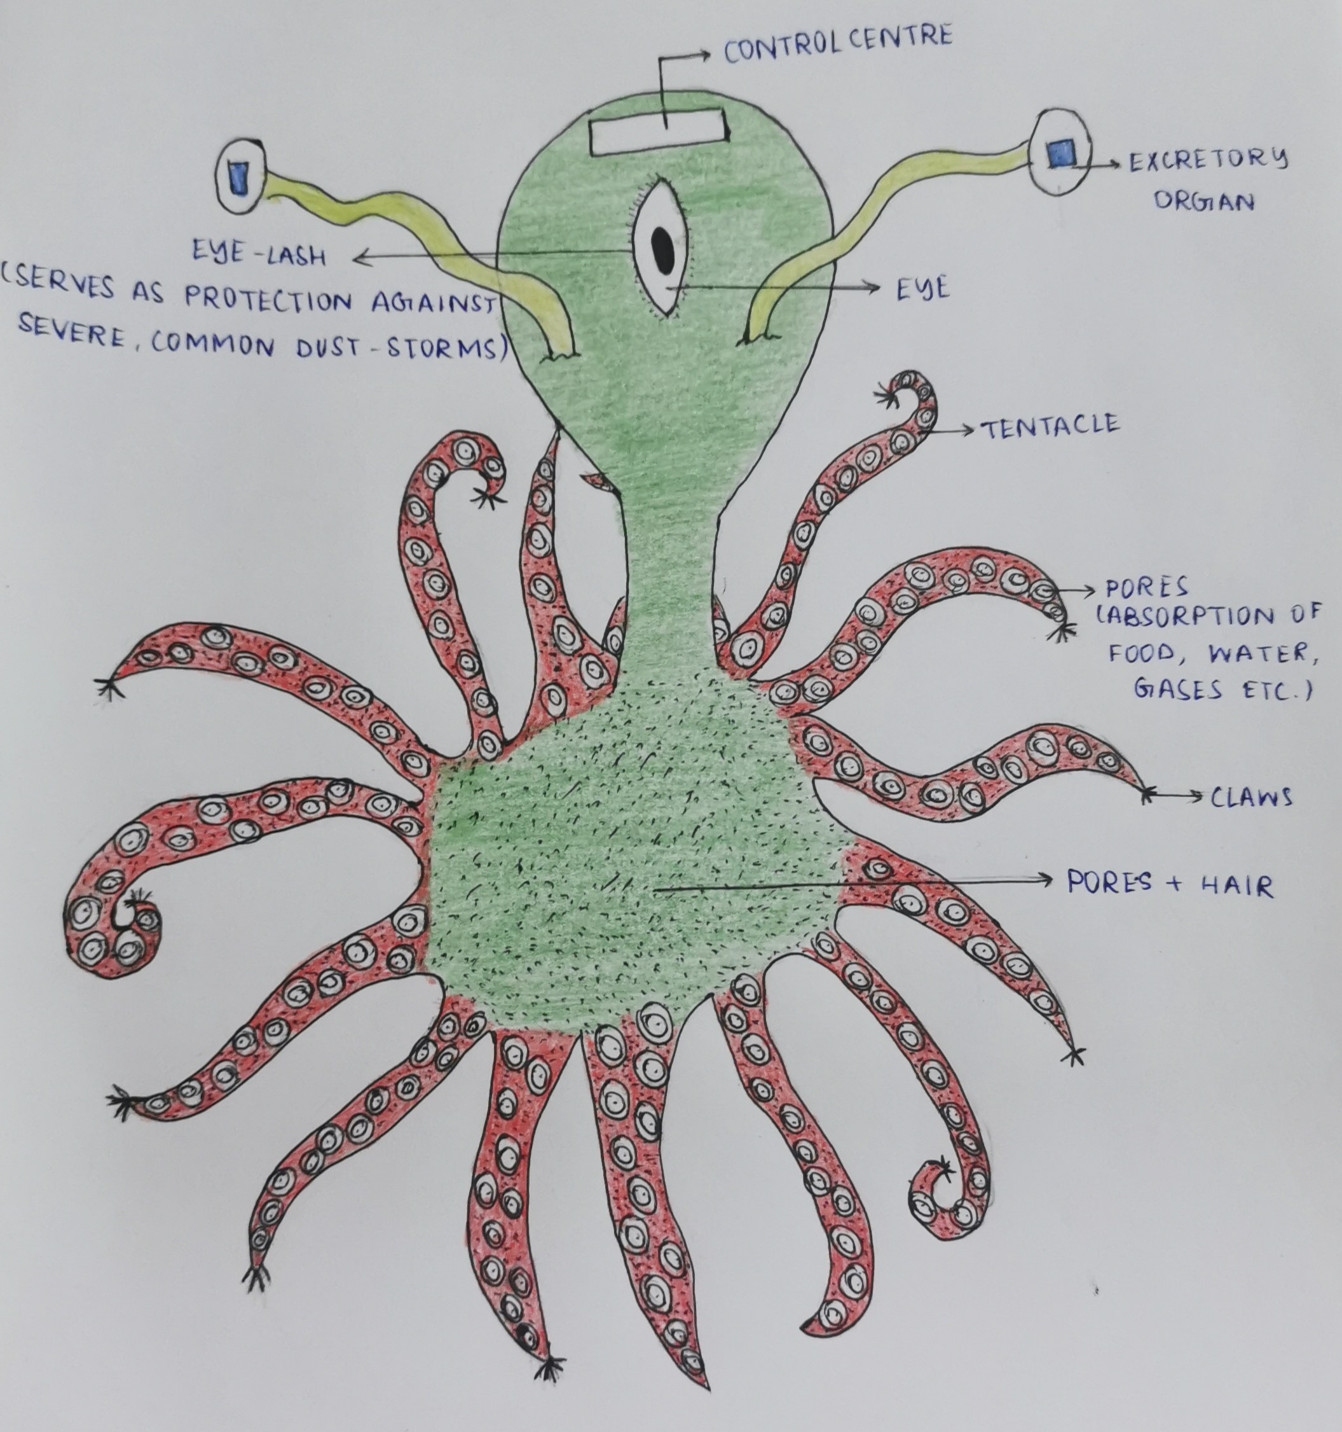
Alien design

Slide 3
DO YOU KNOW THAT MY PLANET IS AS IMPRESSIVE AS YOURS?
MY PLANET IS HOME TO THE LARGEST VOLCANO AND MOUNTAIN IN THE SOLAR SYSTEM – THE OLYMPUS MONS
IT ALSO HAS TWO MOONS – PHOBOS AND DEIMOS.
ONE DAY, MY PLANET WILL ALSO GAIN A RING, LIKE THE LAST 4 PLANETS.
MARS IS NAMED AFTER THE ROMAN GOD OF WAR – ARES AND ITS TWO MOONS ARE NAMED AFTER HIS SONS, FEAR (DEIMOS) AND PANIC (PHOBOS)
HELLO THERE!
I AM ALIEN MASLYP FROM THE PLANET MARS!
I RESIDE NEAR THE POLAR REGIONS OF MY PLANET, BECAUSE THAT’S THE PLACE FROM WHERE WE CAN GET WATER!
NOW, LET ME TELL YOU HOW WE SURVIVE IN MARS AND UNDER ITS CONDITIONS THAT ARE UNFAVORABLE FOR HUMAN HABITATION:

Slide 4
FUN FACT:
THE COMPOSITION OF MARS ATMOSPHERE IS AS FOLLOWS:
95% CARBON DIOXIDE
2.59% NITROGEN
1.94% ARGON
0.161% OXYGEN
0.058% CARBON MONOXIDE
RESPIRATION
WE MARTIANS ARE VERY DIFFERENT FROM HUMANS INDEED.
WE DON’T RESPIRE AEROBICALLY LIKE MOST OF THE HUMANS DO, WE RESPIRE ANAEROBICALLY!
THIS IS BECAUSE, OUR ATMOSPHERE DOES NOT CONTAIN ENOUGH OXYGEN FOR AEROBIC RESPIRATION TO TAKE PLACE.

Slide 5
HETEROTROPHIC MODE OF NUTRITION:
RESEARCHERS HAVE EXPERIMENTALLY PROVED AND HAVE FOUND OUT THAT AGRICULTURE IS POSSIBLE ON MARS. SOME OF THE CROPS THAT CAN BE GROWN ARE:
GARDEN CRESS
TOMATO
ROCKET (ARUGULA)
RADISH
RYE
QUINOA
CHIVES
PEA
LEEK
MODE OF NUTRITION
AUTOTROPHIC MODE OF NUTRITION:
CHEMOAUTOTROPHS ARE CELLS THAT CREATE THEIR OWN ENERGY AND BIOLOGICAL MATERIALS FROM INORGANIC CHEMICALS.
FACT:
ANAEROBIC CHEMOAUTOTROPHS DERIVE ENERGY FROM THE REDUCTION OF CO₂ TO CH₄, OR OF SO₄⁻ TO H₂S.
WE CAN BE BOTH AUTOTROPHIC (CHEMOAUTOTROPHS) AND HETEROTROPHIC

Slide 6
LIFE PROCESSES - NUTRITION
I HAVE BEEN DESIGNED IN SUCH A MANNER THAT HALF OF MY BODY RESEMBLES AN OCTOPUS!
BUT MY TENTACLES DON’T JUST DO THE FUNCTION OF ABSORPTION OF FOOD AND WATER, THEY HELP IN VARIOUS OTHER FUNCTIONS LIKE LOCOMOTION, RESPIRATION AND NUTRITION.
NUTRITION:
TENTACLES ALSO DO THE FUNCTION OF ABSORBING FOOD AND WATER. FOOD CAN BE OTHER PLANTS OR MAYBE EVEN OTHER ORGANISMS.

Slide 7
LIFE PROCESSES - RESPIRATION
WE KNOW THAT PLANTS CAN BE GROWN ON MARS AND THAT PLANTS RELEASE OXYGEN DURING THE PROCESS OF PHOTOSYNTHESIS AND US EUP CO2 DURING THE PROCESS (WHICH IS FOUND ABUNDANTLY IN MARS).
HENCE THE ALIENS CAN ALSO RESPIRE AEROBICALLY.
RESPIRATION:
HALF OF MY TENTACLES DO THE FUNCTION OF RESPIRATION; THEY TAKE UP THE GASES REQUIRED FOR MY SURVIVAL.

Slide 8
LIFE PROCESSES - LOCOMOTION
LOCOMOTION:
THE TENTACLES HAVE CLAW LIKE STRUCTURES AT ITS ENDS. THESE HELP IN EASY LOCOMOTION AND MOVEMENT IN THE ROCKY AREAS OF MARS

Slide 9
MARS DOES NOT HAVE A MAGNETIC FIELD LIKE EARTH. THIS IS BECAUSE MARS HAS NO INNER DYNAMO TO CREATE A MAJOR MAGNETIC FIELD.
THIS IS WHY THERE ARE A LOT OF RADIATIONS INFLICTED ON MARS BY THE SUN
PROTECTION
WE ARE FURRY AND HAIRY TO PROTECT OURSELVES FROM THE HARSH WEATHER OF OUR PLANET.
THIS ALSO PROVIDES US WITH INSULATION.
THIS ALSO HELPS IN PROTECTING OURSELVES FROM THE POWERFUL AND HARMFUL RADIATIONS OF THE SUN.
FUN FACT:
MARS ONCE DID HAVE A MAGNETIC FIELD LONG AGO. BUT IT SHUT DOWN SUDDENLY ABOUT 4 BILLION YEARS AGO FOR REASONS UNKNOWN LEAVING IT OPEN AND VULNERABLE TO THE HARMFUL RADIATIONS OF THE SUN.

Slide 10
FACE STRUCTURE
OUR EXCRETORY ORGANS ARE SITUATED ON EITHER SIDE OF OUR EYE.
OUR WASTE PRODUCTS ARE EXCRETED VIA THESE APPENDAGES
MOREOVER, WE ARE INVERTEBRATES AND DO NOT HAVE A SPINE OR A BACKBONED S
WE DO NOT HAVE A BRAIN LIKE THE HUMANS, RATHER WE HAVE A SMALL BOX LIKE STRUCTURE ON OUR FOREHEAD. THIS IS WHERE OUR CONTROL CENTRE OF THE BODY IS LOCATED.
WE HAVE ONE SINGLE EYE WHICH ENABLES US TO SEE THE WORLD.
WE DO NOT HAVE EARS, RATHER WE JUST HAVE TWO PORES ON EITHER SIDE OF OUR HEAD VIA WHICH WE HEAR.

Slide 11
CIRCULATORY SYSTEM
WE DO NOT HAVE A CLOSED CIRCULATORY SYSTEM LIKE HUMANS. IN FACT WE HAVE AN OPEN CIRCULATORY SYSTEM WITH A HEART AND HAEMOCOEL. THIS SYSTEM HELPS US LIVE UNDER REDUCED PRESSURES!
THE AIR DENSITY A.K.A ATMOSPHERIC PRESSURE OF MARS IS 1/1000 TIMES LESSER THAN THE AIR DENSITY OF EARTH. HENCE IF WE HAD A CLOSED CIRCULATORY SYSTEM LIKE THE HUMANS, WE WOULD NOT BE ABLE TO SURVIVE IN MARS AS THE HUGE PRESSURES OF OUR OWN BLOOD WOULD KILL US.

Slide 12
THANK YOU.
PRESENTATION IS DONE BY JANANI RAJESH KUMAR
GR090051
BATCH – ARYA A1

